Slide 1
Social change is a change in the social structures and functions of those Structures. The term social change is also used to indicate the changes that take place in human interactions and interrelations. For example Change in Structure and Functions of family (Joint to Nuclear Structure of Family and Change in functions of family).
For Maciver and Page, Society is a web of social relationships and hence social change means change in the system of social relationships. These are understood in terms of social processes and social interactions and social organization.
Auguste Comte the father of Sociology has posed two problems- the question of social statics and the question of social dynamics, what is and how it changes. The sociologists not only outline the structure of the society but also seek to know its causes also.
According to Morris Ginsberg social change is a change in the social structure.
Change is the law of nature. What is today shall be different from what it would be tomorrow. The social structure is subject to incessant change..

Slide 2
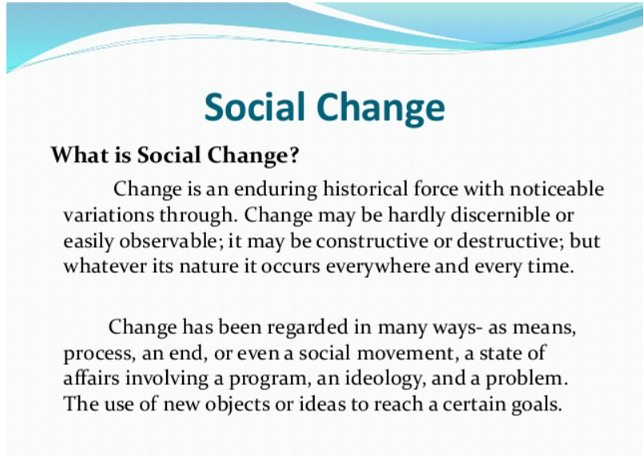

Slide 3
Forms of Social Change
Generally social change occurs in two forms.
Change in the system:- It means all the small changes occurring in the system come under this form of social change. Karl Marx has described it in the form of quantitative changes. Such changes keep going on in all the societies like premature communism, ancient society, similarly plenty of changes coming up in modern societies in all areas are the ways of change in the system. Given so much importance to children and women in today’s family, is indicator of change in relations. Parsons has also talked about such kind of change.
Change of the system:- Though, this form of change, brings change in the whole system, for eg the qualitative change explained by Karl Marx described, this kind of change, because under qualitative change, the whole system is replaced by another system. Similarly, if it happens that in India, caste system in completely abolished and absolute class system is established then it would be said to be change of the system.

Slide 4
Direction of Social Change:
Though there is not any fixed direction of change and so there is nothing absolute to describe it. But maclver and Page have given, in general, the following directions of change
Forward direction of change: Shows a definite positive change. This is usually seen in the field of science and technology, which in turn, change the existence of life and knowledge.
Downward/Backward direction of change:– Some changes occur, upwards initially but later on a process of degeneration starts, economic change in the best example of it. Metropolitan cities also decay after a big change. In International market also this kind of change in seen.
Wave Like change: – Another direction of change happens as a wave ambulance like motion and example of such kind of changes are seen in the field of fashion, styles of living, attires etc. Which after sometime repeat itself. It does not have any fixed direction of high level of change.

Slide 5
Factors of Social Change
Internal Factors:- Change in population and geographical conditions, change in production process migration, Individual interests, communal conflicts, change in physical consumerism like in science and technology industrialization, urbanization, consumerism lifestyle etc.
External Factors:– Cultural contact is the main external factor, which could be direct or indirect and which beings change in the form of acculturation, assimilation and diffusion for eg. India realized change under the direct influence of Islam and Western culture and especially westernization has put a great impact on our societies, in all spheres of life.

Slide 6
Nature of Social Change
Social change is a universal phenomenon. Social change occurs in all societies. No society remains completely static.
Social change is community change. Social change does not refer to the change in the life of an individual or the life patterns of several individuals.
Speed of social change is not uniform. While social change occurs in all societies, its speed is not uniform in every society.
Nature and speed of social change is affected by and related to time factor. The speed of social change is not uniform in each age or period in the same society.
Social change occurs as an essential law. Change is the law of nature. Social change also is natural.
Definite prediction of social change is not possible. It is difficult to make any prediction about the exact forms of social change.
Social change results from the interaction of a number of factors.
Social change are chiefly those of modification or of replacement. Social changes may be broadly categorized as modifications or replacements.

Slide 7
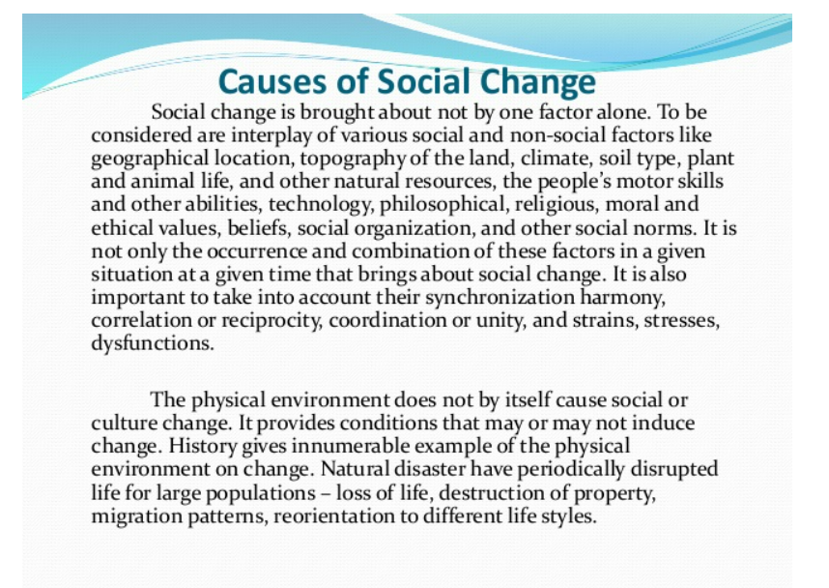

Slide 8
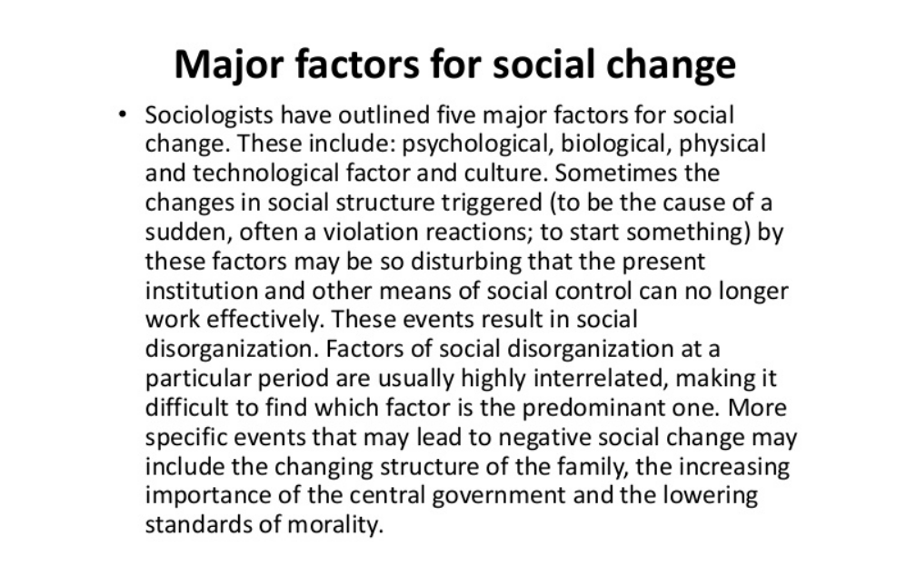

Slide 9
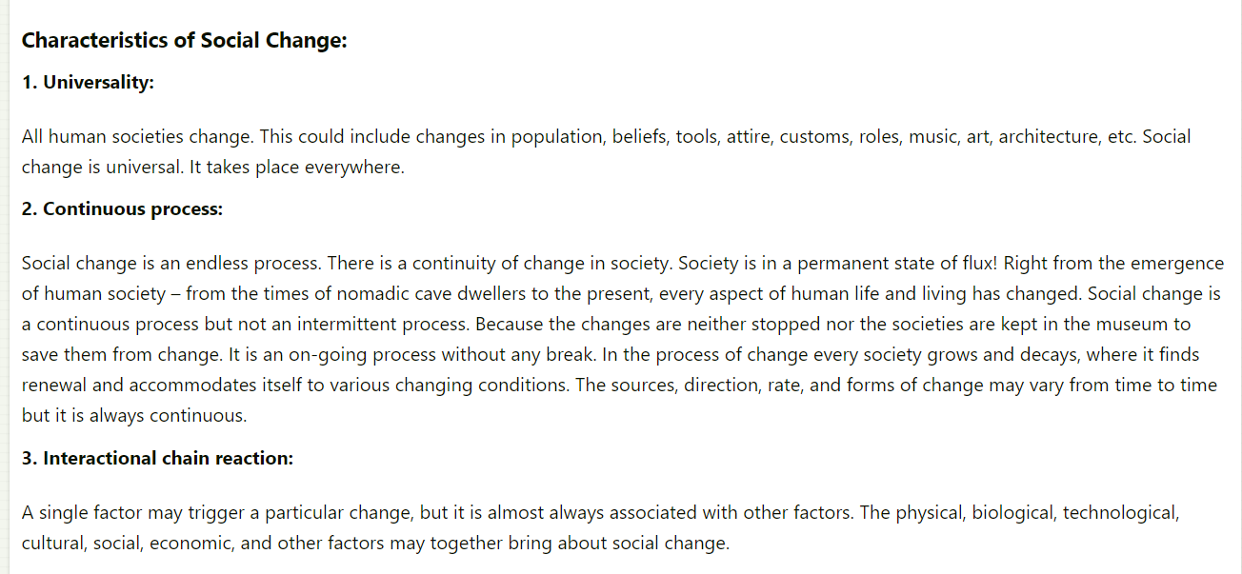

Slide 10
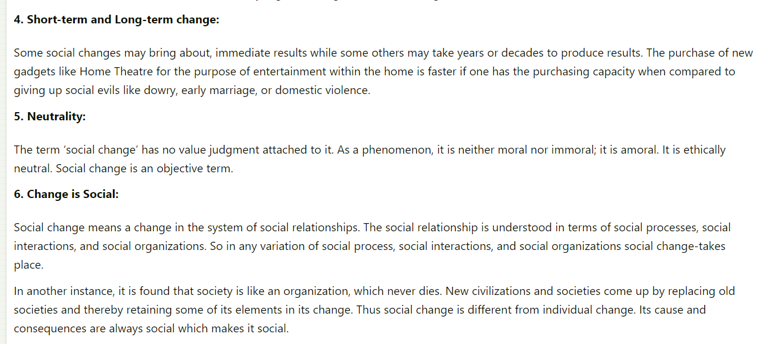

Slide 11
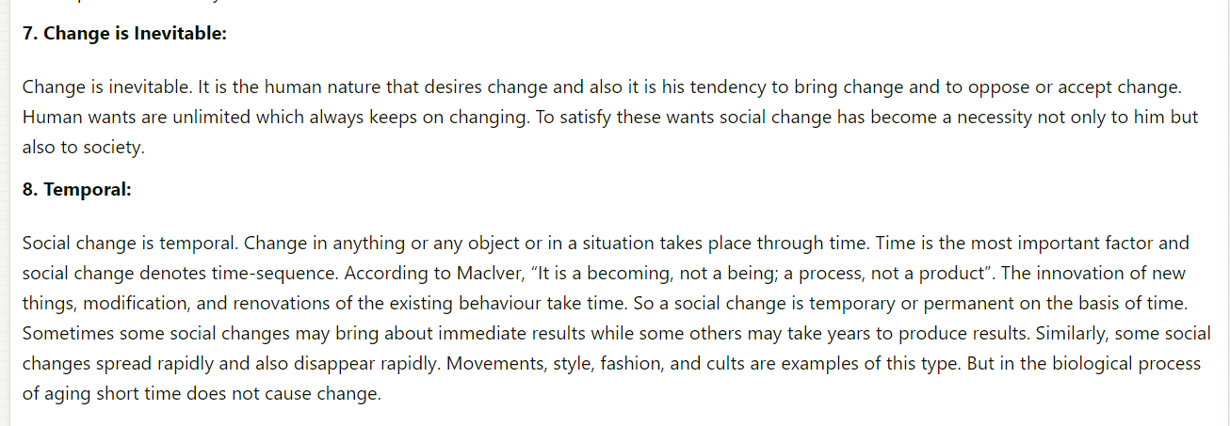

Slide 12
Inevitable
As mentioned earlier, social change is a phenomenon tied to the very root of human society, therefore it is inevitable and unavoidable. Social change may take place without society being acutely aware of the process.
Ubiquitous
Social change is not a concept tied down to one society, it is not unique to particular geographical locations or subsets of society but occurs across all societies. No society remains static and unchanging
Multi-leveled
As discussed above, change occurs both on a micro and macro level. Certain definitions of social change look at the concept to understand how social structures evolve and introduce new social institutions.
Contagious
Especially in the present day, given how interwoven and connected one society is with another, social change is contagious in the sense that change in one society can inflict change in another.

